Slide 1
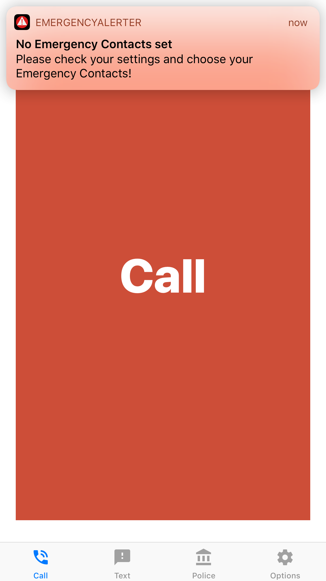
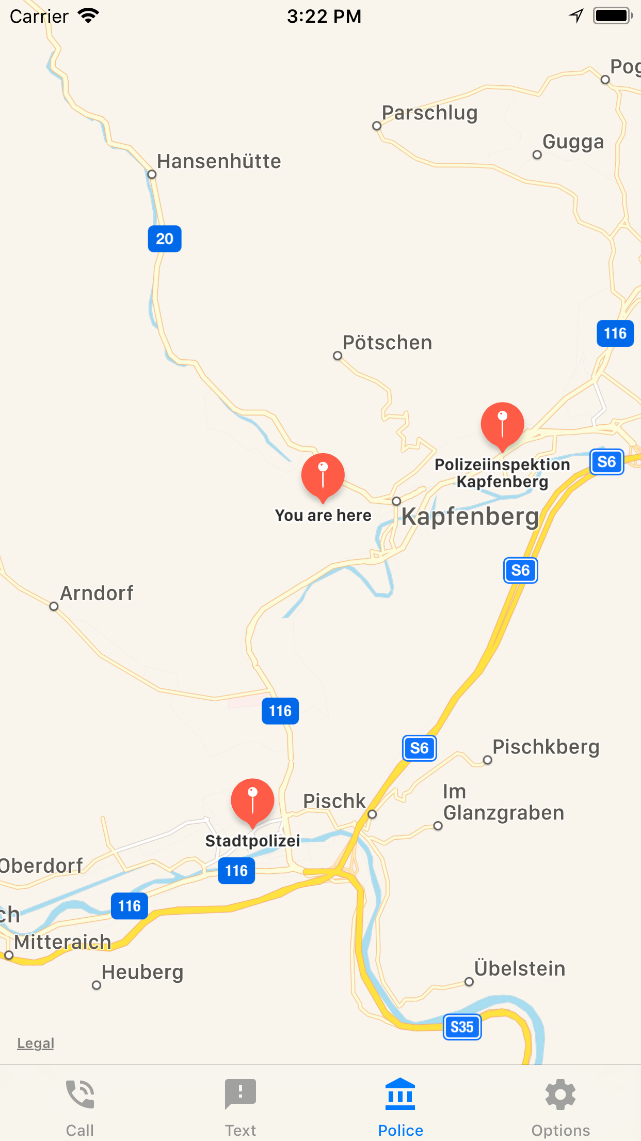
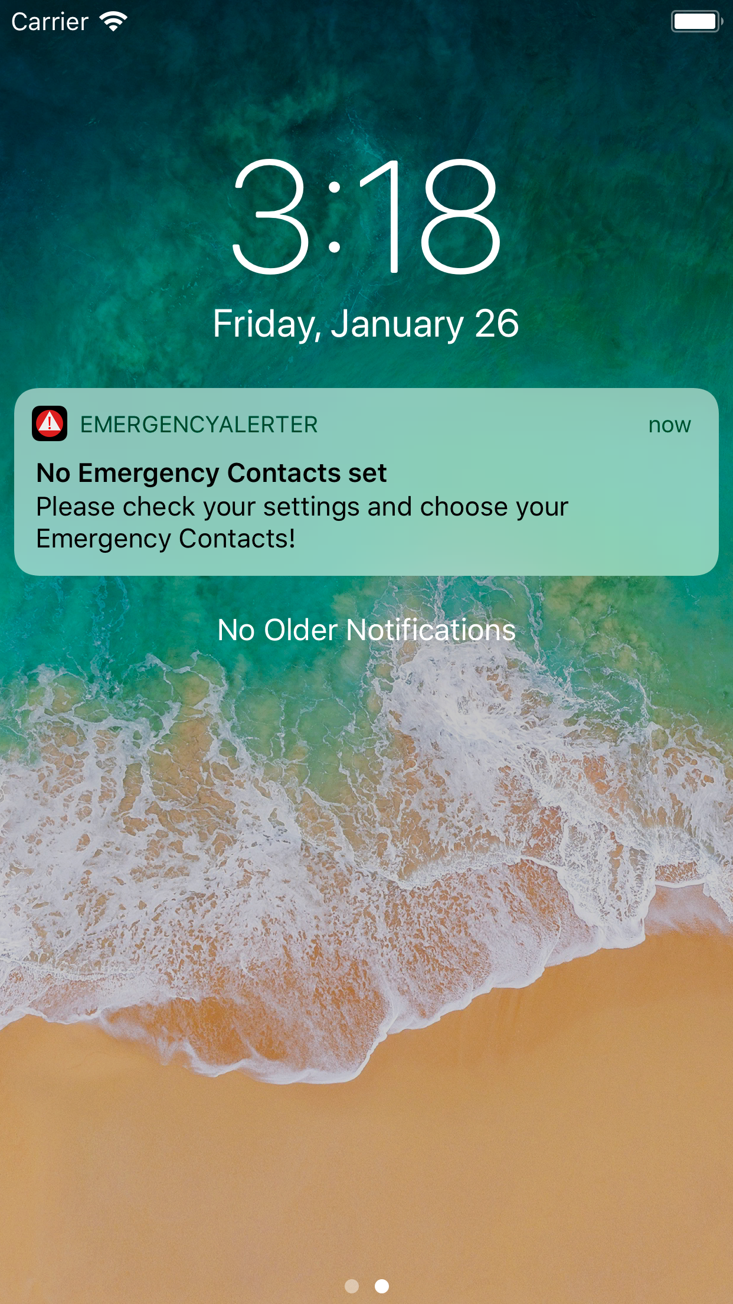
EmergencyAlerter
IT & Mobile Security
Florian Mayerhofer, Michael Stifter, Arlinda Butja
Show nearest Police station
SMS Alert
Call Emergency Contact
Shake phone in emergency

